Slide 1
Surgical Video Generation
Liu Junlin, Wang Qianyi
Advisor: Liu Jiang, Hu Yan

Slide 2
Contents
Background
Modeling Tasks
Video Generation
Frame Interpolation
Evaluation Criterion
Further Works

Slide 3
Background
Clinical needs
Lack of intuitive personalized preview of a surgery
Lack of intuitive preview of effects after surgery
Medical model training needs
Datasets are not complete videos, but extraction of frames
Lack of video datasets in rare surgical cases

Slide 4
Modeling Tasks
Generate Surgical Images in Different Stages
Generate Surgical Videos in Different Stages
Surgical Video Frame Interpolation

Slide 5
Video Generation
PART I

Slide 6
Content
LVDM: A diffusion-based baseline method for efficient video generation
LAVIE: High-Quality Video Generation With Cascaded Latent Diffusion Models
SMA: Spectral Motion Alignment for Video Motion Transfer using Diffusion Models

Slide 7
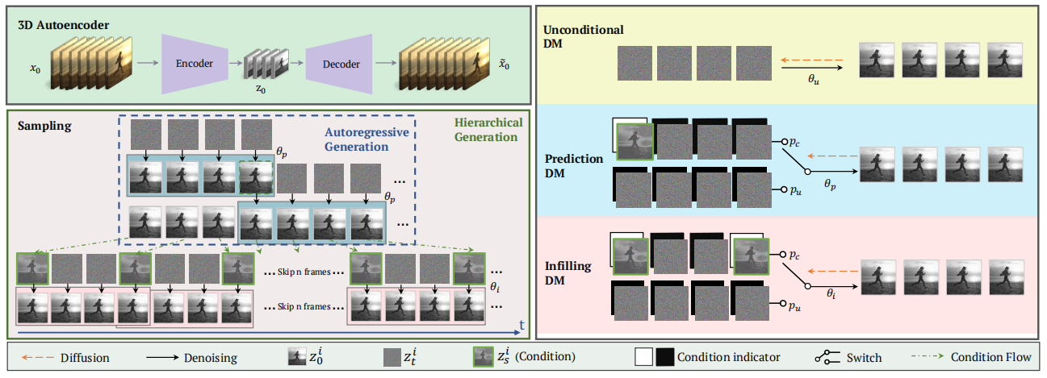
Pipeline

Slide 8
Video Autoencoder
A lightweight 3D autoencoder is used to compress the video, including an encoder E and a decoder D, both of which consist of several layers of 3D convolutions.

Slide 9
Short Video Generation
Following the method in VDM, the 3D U-Net architecture with spatio-temporal decomposition is used for estimation. A 1×3×3 space-only 3D convolution is used and temporal attention is added in part of the layers.

Slide 10
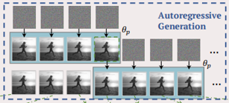
Long Video Generation
An additional binary mask is added on the channel dimension to indicate whether it is a condition frame or a frame to predict.

Slide 11
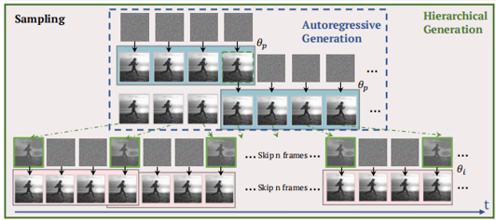
Long Video Generation
An autoregressive video generation model is first trained on sparse frames to form the basic storyline of the video, and then another interpolation model is trained to fill in the missing frames.

Slide 12
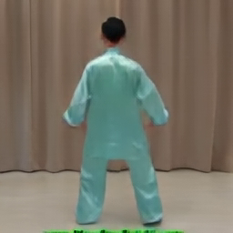
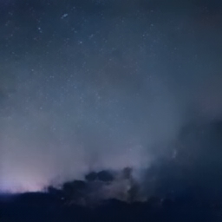
Generation Result: Unconditional

Slide 13
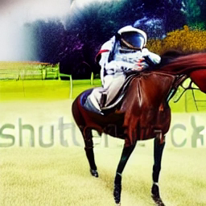
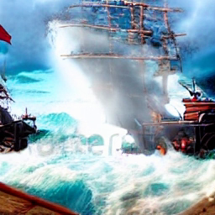
Generation Result: Text to Video
astronaut riding a horse
Flying through an intense battle between pirate ships in a stormy ocean

Slide 14
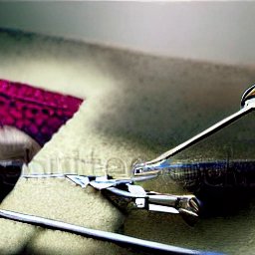
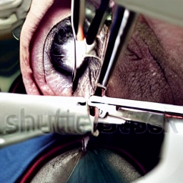
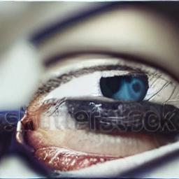
Generation Result: Text to Video
Cataract surgery
Capsulorhexis
Capsulorhexis Forceps
Cataract surgery
triangular scalpel cut into the cornea
cataract
eyes
incision

Slide 15
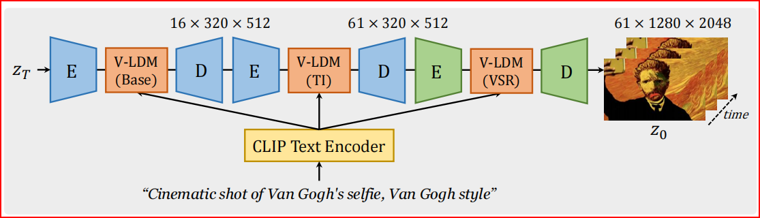
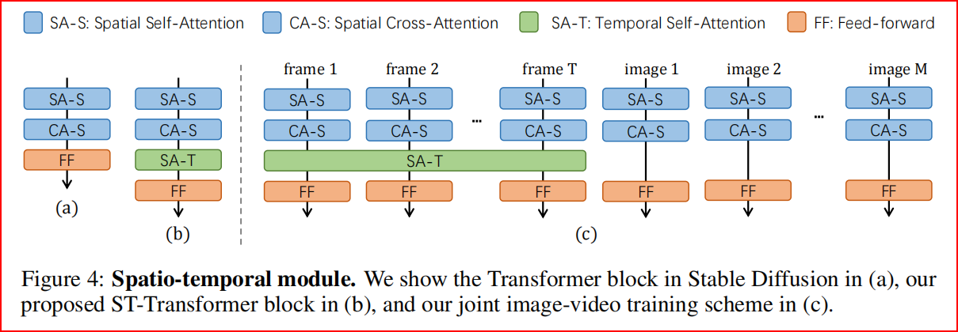
LAVIE: High-Quality Video Generation With Cascaded Latent Diffusion Models
A text-to video foundation model based on Stable Diffusion
Extend the original transformer block to a Spatio-Temporal Transformer by including a temporal attention layer after each spatial layer.
Incorporate the concept of Rotary Positional Encoding (RoPE) to integrate the temporal attention layer.

Slide 16
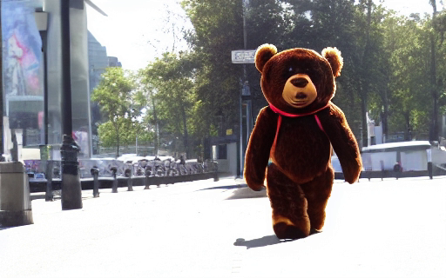
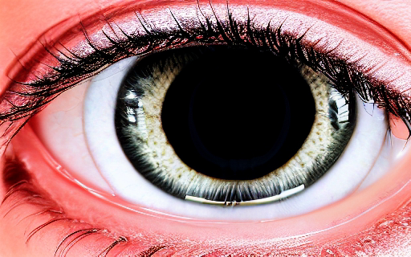
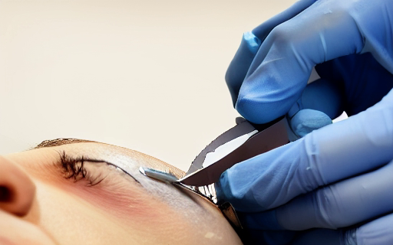
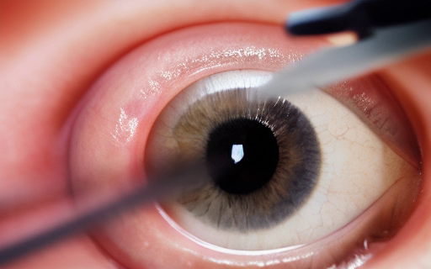
Result
A teddy bear walking on the street
cataract_surgery, incision, puncture_knife
A puncture knife doing incision in a cataract surgery
A close-up view of an eye undergoing a cataract surgery incision with a puncture knife

Slide 17
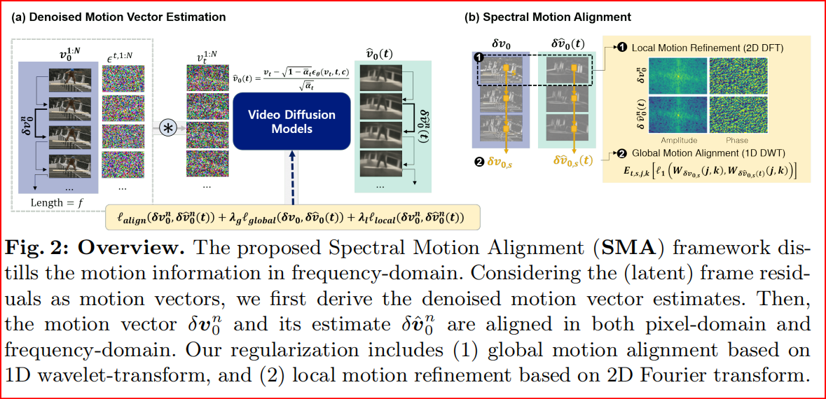
SMA: Spectral Motion Alignment for Video Motion Transfer using Diffusion Models
Denoised Motion Vector Estimation: Illustrates the process of deriving denoised motion vector estimates.
Local Motion Refinement (2D FFT): Prioritize low frequencies to reduce high-frequency noise not related to motion.
Global Motion Alignment (1D DWT): Aligning the predicted and actual motion vectors within the wavelet domain.

Slide 18
Frame Interpolation
PART II

Slide 19
Content:
Review
MCVD: Masked Conditional Video Diffusion for Prediction, Generation, and Interpolation
LDMVFI: Video Frame Interpolation with Latent Diffusion Models
Research
DQBC: Video Frame Interpolation with Densely Queried Bilateral Correlation
Comparison

Slide 20
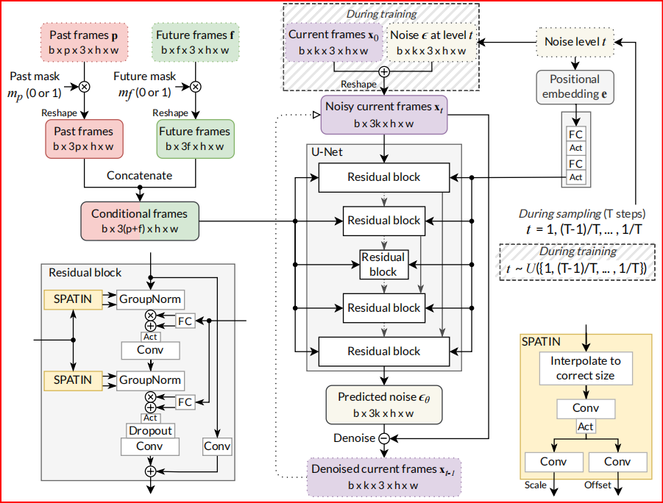
MCVD: Masked Conditional Video Diffusion for Prediction, Generation, and Interpolation
Randomly mask past and future frames with p=1/2.
Give noisy current frames to a U-Net whose residual blocks receive conditional information from past/future frames and noise level.
The output is the predicted noise levels noise in the current frames, which we use to denoise the current frames.

Slide 21
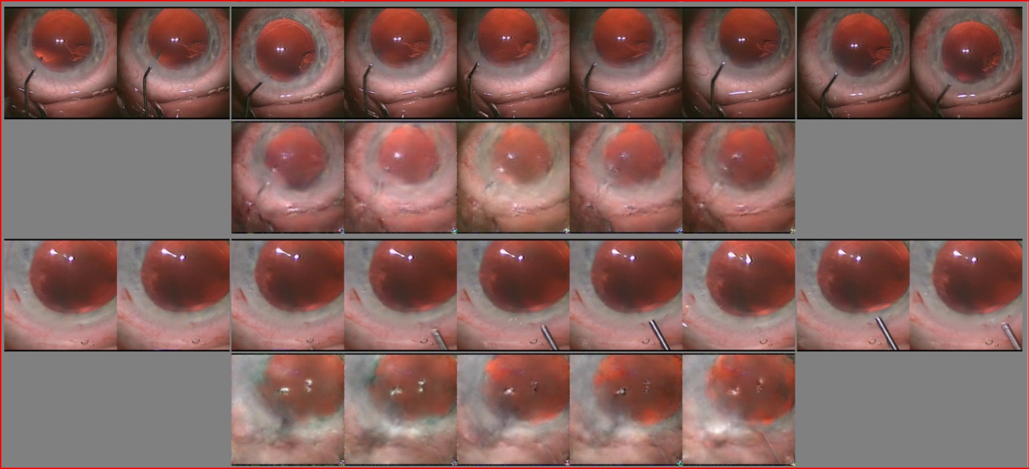
Result Review: MCVD

Slide 22
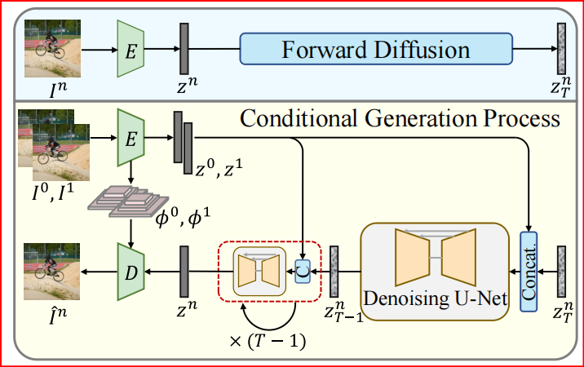
LDMVFI: Video Frame Interpolation with Latent Diffusion Models
A VFI-specific autoencoding model, VQ-FIGAN, that projects frames into a latent space, and reconstructs the target frame from the latent encoding.
A denoising U-Net that performs a reverse diffusion process in the latent space for conditional image generation.

Slide 23
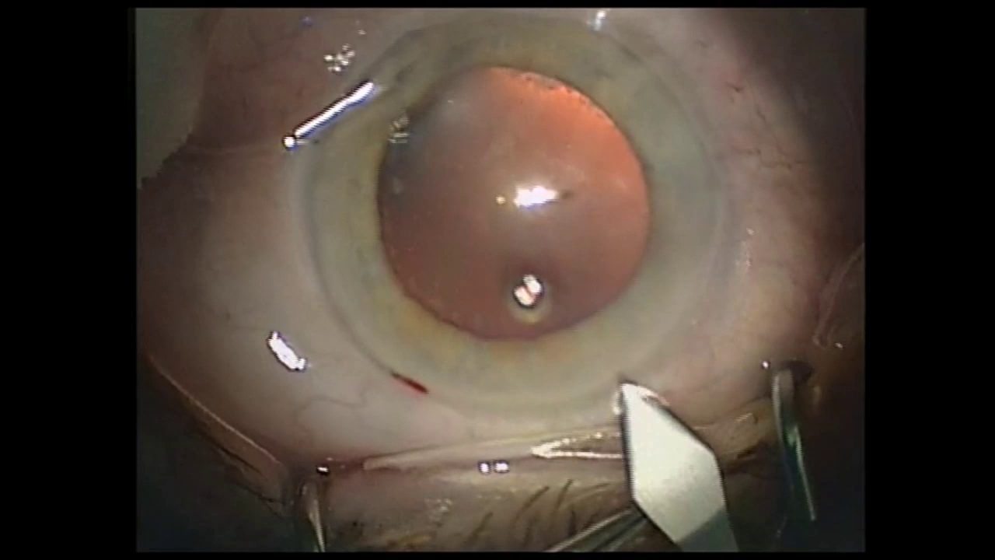
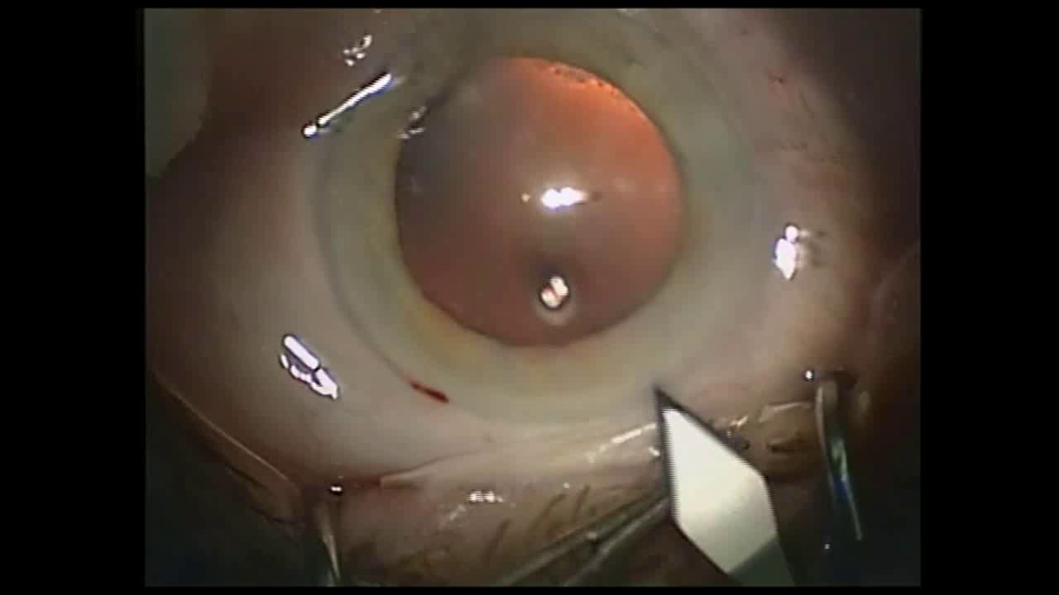


Result Review: LDMVFI(1)
Original
Clipped2FPS
8FPS
Interp.
16FPS
Interp.

Slide 24
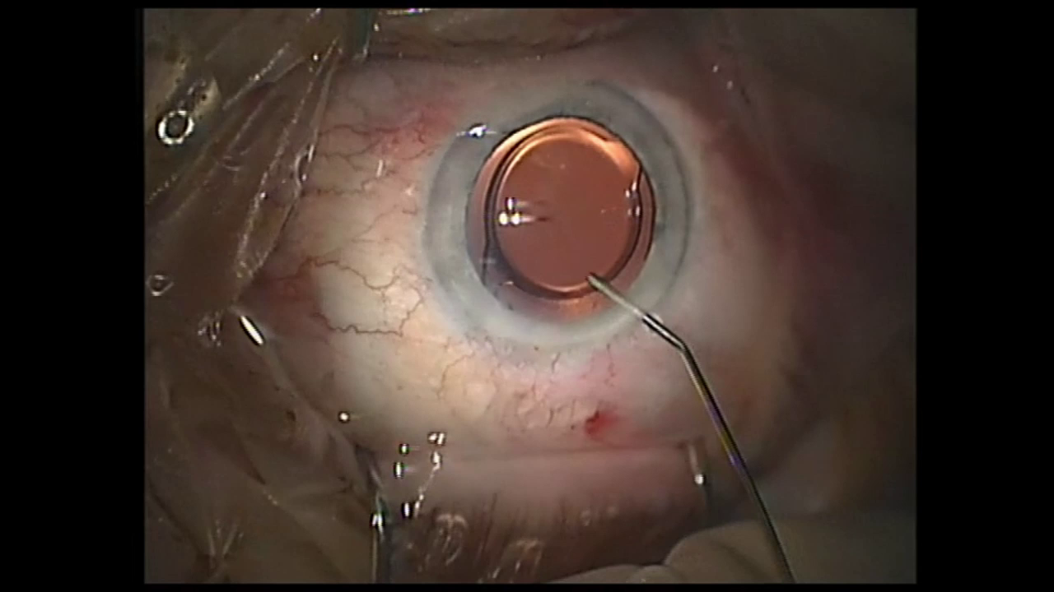
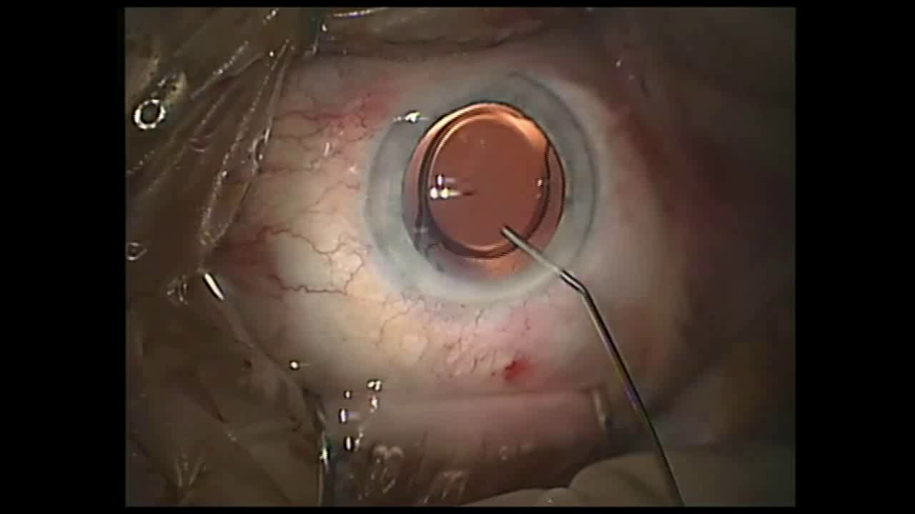

Result Review: LDMVFI(2)
Original
Clipped4FPS
8FPS
Interp.
16FPS
Interp.

Slide 25
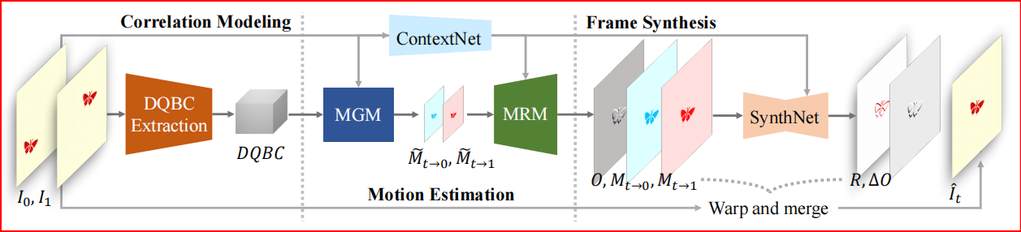
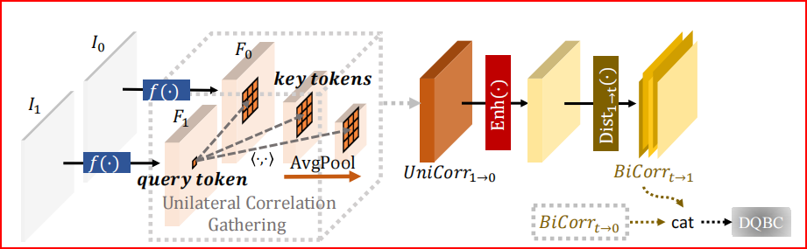
DQBC: Video Frame Interpolation with Densely Queried Bilateral Correlation
Motion Generation Module (MGM) generates preliminary motion fields with the help of DQBC.
Tokens in F1 are taken as queries and tokens in local windows on several down-sampled F0 are taken as keys to compute similarities.

Slide 26
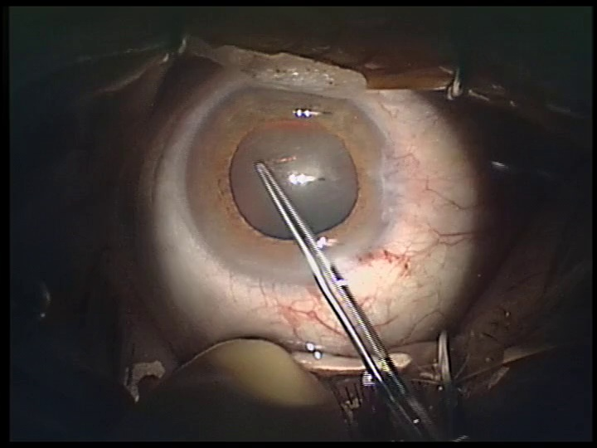
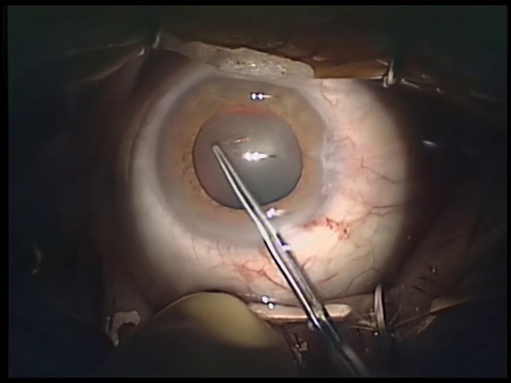
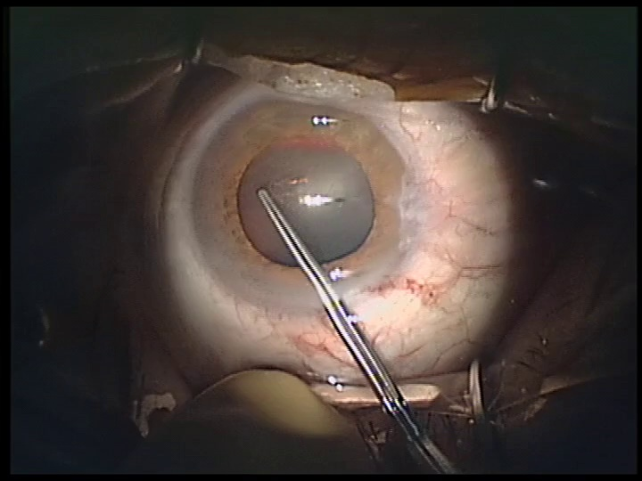
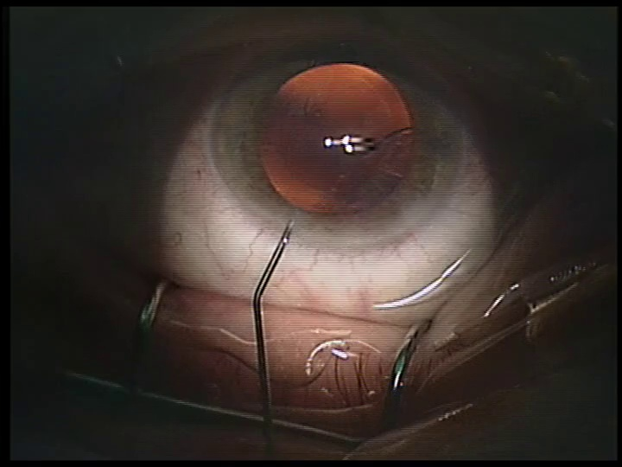
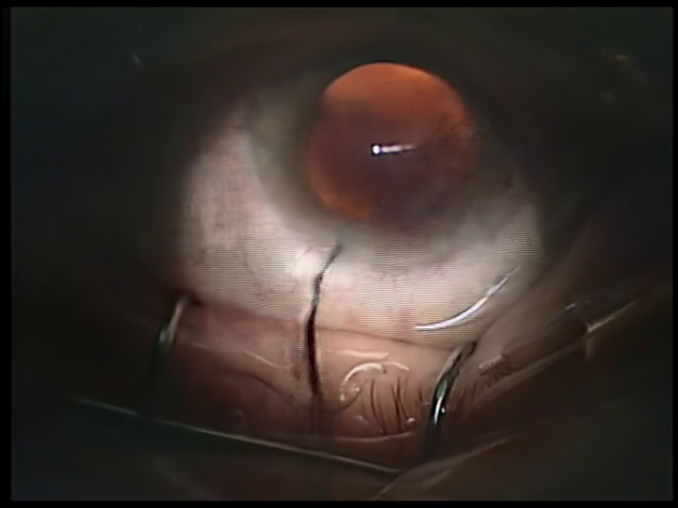
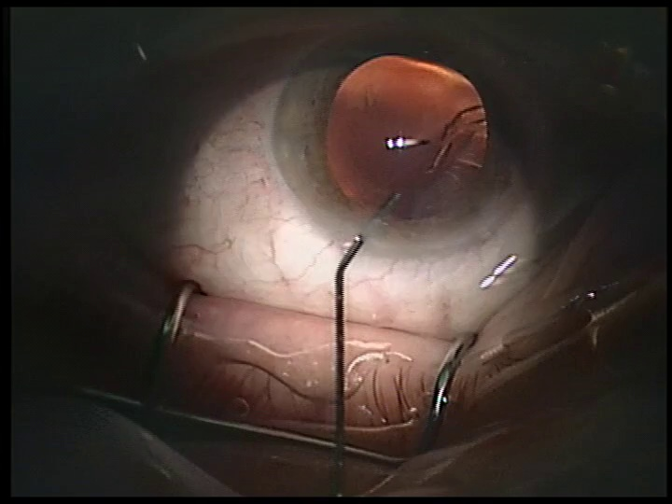
Result: DQBC(1)

Slide 27
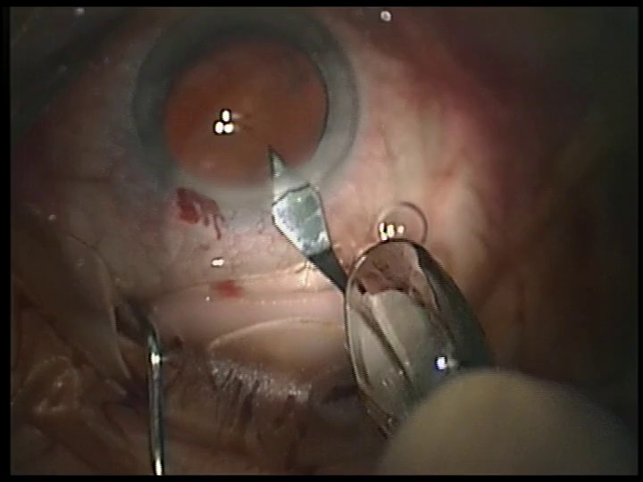
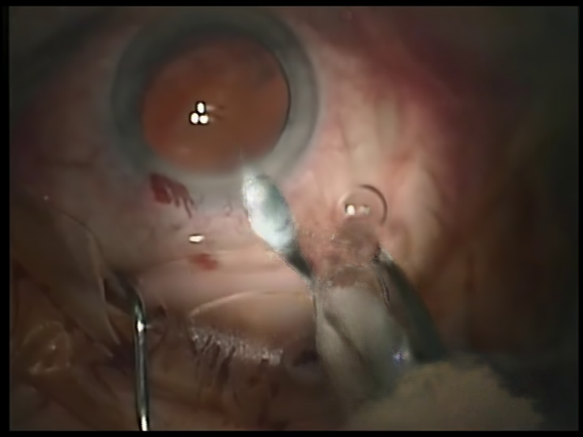
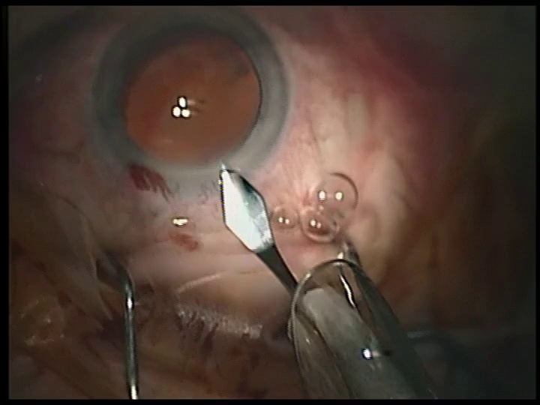
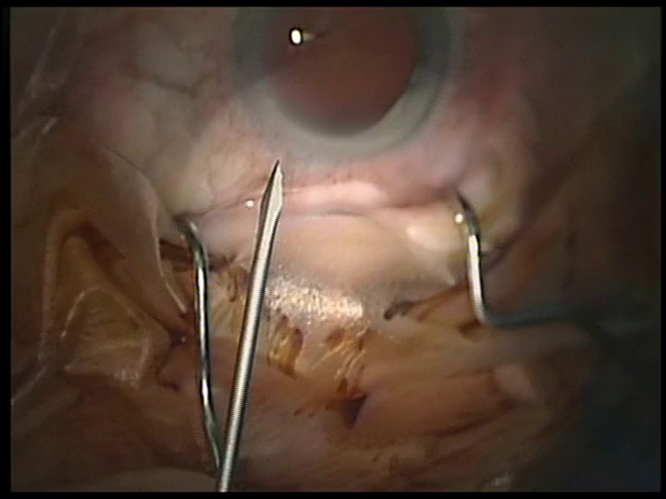
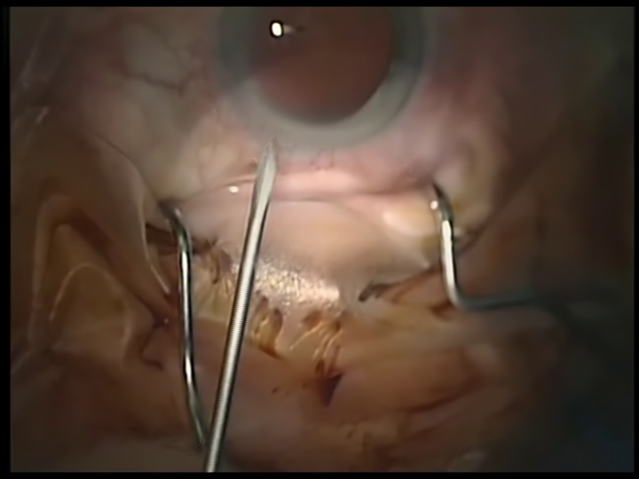
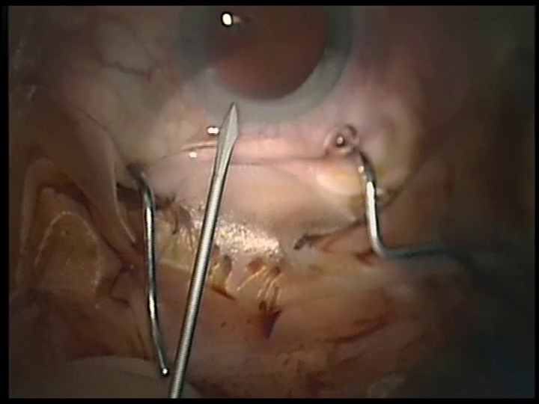
Result: DQBC(2)

Slide 28
Comparison
MCVD: Hard to train, slow infernece speed, poor interpolation result, the noise is not completely decoded and the motion is hard to learn.
LDMVFI: Better to train, decent infernece speed, rather high interpolation result, but will generate artifact.
DQBC: Fast inference speed, captures the rapid motion of instruments with high precision, but the motion part is blurred.

Slide 29
Evaluation Criterion
PART III

Slide 30
Content:
PSNR: Peak Signal-to-Noise Ratio
SSIM: Structured Similarity Index Measure
FID: Fréchet Inception Distance
CLIPSM: CLIP Similarity

Slide 31
PSNR: Peak Signal-to-Noise Ratio
The ratio between the maximum possible power of an image and the power of corrupting noise that affects the quality of its representation.
Higher is better.
PSNR*: Ensures that each pixel has equal weight in the evaluation, rather than each frame having equal weight. This is very important for assessing regions with different numbers of pixels (e.g., partially occluded areas).
SSIM: Structured Similarity Index Measure
Measures the perceptual and structure difference between the two images.
Higher is better.

Slide 32
FID: Fréchet Inception Distance
Evaluates the similarity of generated images to real ones on the feature level.
Lower is better.
FVD is to evaluate the temporal coherence of the content of a video, in addition to the quality of each frame
CLIPSIM: CLIP Similarity
Utilize the multi-modal model CLIP, which has zero-shot capabilities, to output text and image similarity. When used in video tasks, take the average of the similarity of each frame.
Higher is better.

Slide 33
Further Works
PART IV

Slide 34
Main Idea
Integrate video diffusion models to learn the motion.
Modify LDMVFI for better frame interpolation.
Text to frames -> generate video -> frame interpolation.

Slide 35
Thanks for Your Attention

